Slide 1
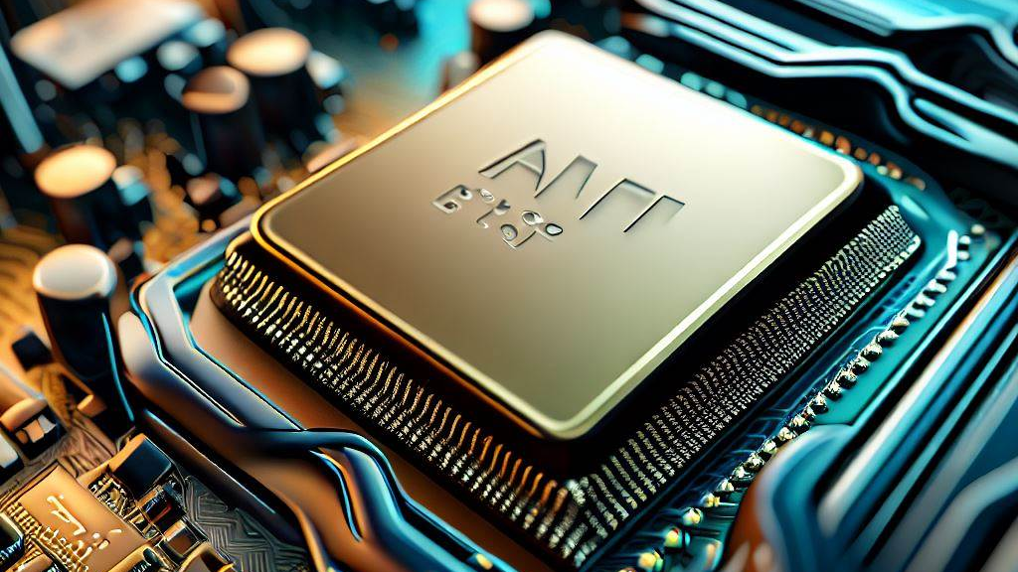
Arm Processor and it’s Application
TEAM-4

Slide 2

TEAM DETAILS:
NAME | USN | ROLL NO
Pralhad Yadwad | 01FE21BEC186 | 412
Rakshita Salgeri | 01FE21BEC222 | 442
Anusha.A.D | 01FE21BEC231 | 451
Ashrit.Ambalimath | 01FE21BEC241 | 460

Slide 3

Problem statement:
In a manufacturing unit of soaps, the conveyor carries the soaps to store in a carton with a capacity of 10 soap units, it sometimes happens that the carton is found empty while dispatching. Design a system to prevent the above problem

Slide 4
The peripherals used to solve this problem are a DC motor, stepper motor, ultrasonic sensor, and LCD. The conveyor belt runs on the DC motor, and the carton moves over it. We assume that the carton is full if it has soaps with a distance of 5cm, and it is empty if the distance is greater than 5cm. The status of the carton is displayed on the LCD based on the distance measured. If it is empty, the carton is pushed away, which is accomplished by the rotation of the stepper motor.
INTRODUCTION:

Slide 5
Algorithm.
ALGORITHM
Step1.Start
Step2. Initialize the system and all sensors (ultrasonic sensor).
Step3. Set up the DC motor to drive the conveyor belt.
Step4. Read the ultrasonic sensor to detect the height of the passing carton.
Step5. IF the height is greater than 5cm:
Display carton is empty
Activate the stepper motor to push the empty carton off the conveyor.
ELSE IF the height is less than 5cm:
Display carton is full
Step6.Repeat the loop.
Step7. Stop
Step 1: Initialize the peripherals (GPIO, UART, etc.) of LPC2148.
Step 2: Configure the PIR sensor pin as an input.
Step 3: Configure the stepper motor pins as outputs.
Step 4: Initialize the UART communication settings.
Step 5: Initialize a variable to keep track of the token number.
Step 6: Create a loop to continuously monitor the PIR sensor.
Step 7: If motion is detected (PIR sensor output is LOW), proceed to the token generation process.
Step 8: Rotate the stepper motor to distribute the token.
Step 9: Display the generated token number on the UART.
Step 10: Wait for a short delay to avoid multiple token generations for the same motion event.
Step 11: Repeat the process for each person.

Slide 6

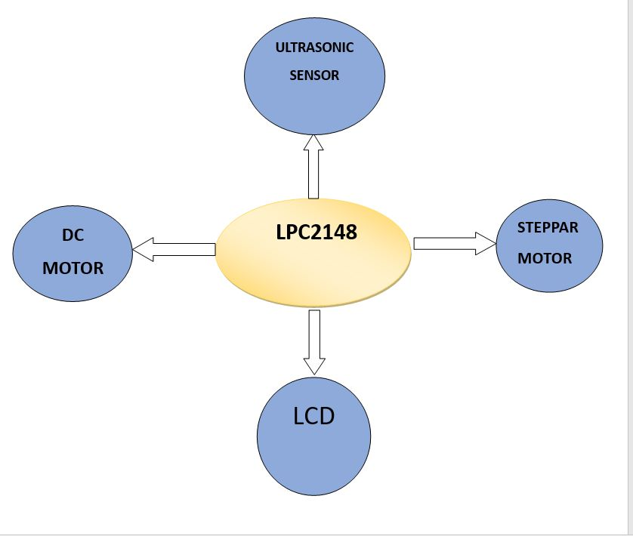

Slide 7
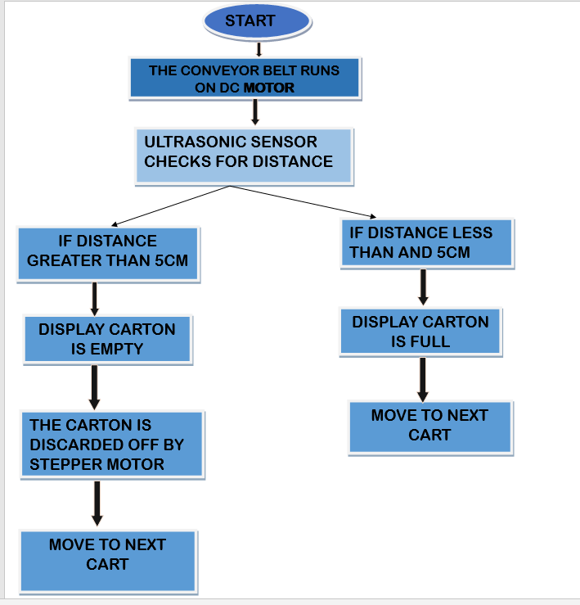

Slide 8

PERIPHERALS USED
1)ULTRASONIC SENSOR
2)DC MOTOR
3)STEPPER MOTOR
4)LCD (16X2)
5)UART

Slide 9
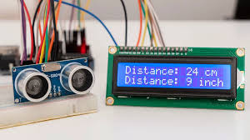
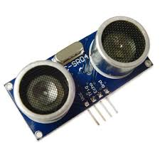
ULTRASONIC SENSOR:
An Ultrasonic Sensor is a device that uses sound waves to measure the distance of an object from the sensor. It works on the principle of emitting high-frequency sound waves (ultrasonic waves) and then measuring the time it takes for those waves to bounce back after hitting an object. The sensor consists of a transmitter and a receiver.
Ultrasonic sensors are commonly used in various applications such as object detection, distance measurement, obstacle avoidance, and level sensing. They are widely used in robotics, industrial automation, and other fields where non-contact distance measurements are required.

Slide 10
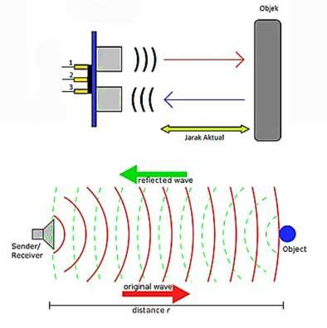
Initialization: The ultrasonic sensor is connected to a microcontroller or a similar device. Before any measurement, the sensor is initialized, and necessary parameters are set, such as the trigger pin and echo pin configurations.
Trigger Pulse: To start the measurement process, a trigger pulse is sent from the microcontroller to the Ultrasonic Sensor's trigger pin. This pulse is typically a short burst of electrical signal, usually with a duration of 10 microseconds.
Ultrasonic Wave Emission: When the sensor receives the trigger pulse, it activates its ultrasonic transducer, which converts the electrical signal into high-frequency sound waves (ultrasonic waves). These waves travel through the air at the speed of sound.
Wave Reflection: When the ultrasonic waves encounter an object or obstacle in their path, they get reflected back towards the sensor. Echo Reception: The ultrasonic sensor's receiver now picks up the reflected waves (echo) and converts them back into electrical signals.
Time Measurement:. By measuring the time elapsed between sending the trigger pulse and receiving the echo, the round-trip time for the ultrasonic waves is determined.
Distance Calculation: formula: Distance = (Speed of Sound * Time Elapsed) / 2.

Slide 11
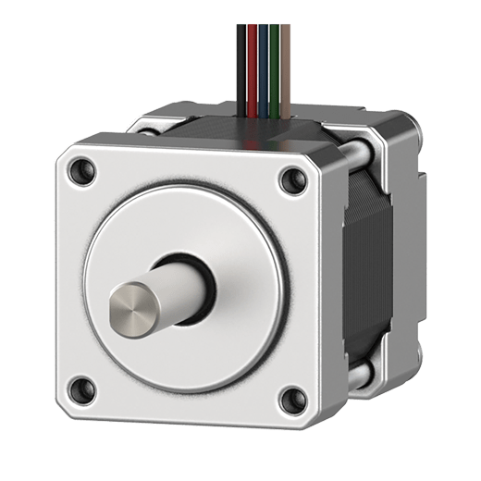
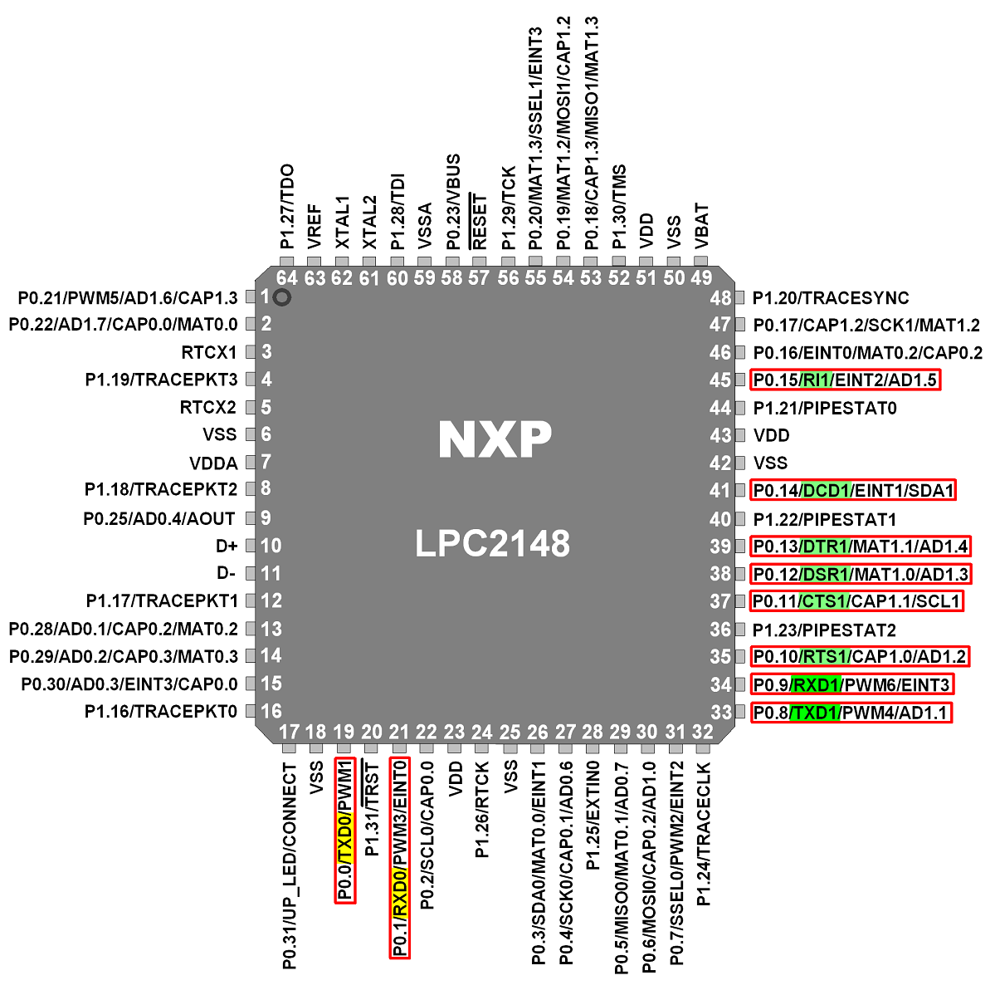
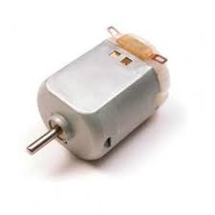
INTERFACING DAIGRAM
UART
INPUT
(send the signals )
PROCESSOR
(Processes the input signals and
Send the output signals according to the command )
DISPLAY EMPTY OF FULL
OUTPUT
( Works are given instruction by the processor)

Slide 12
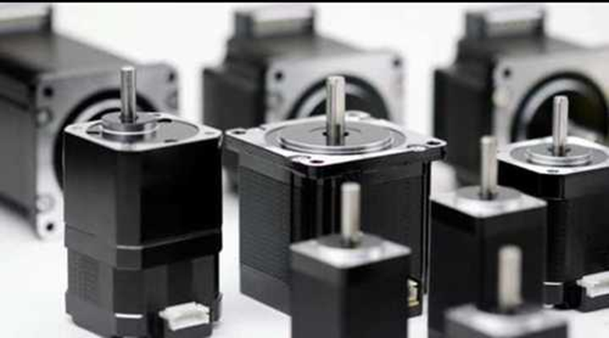
Stepper Motor
A stepper motor is a type of electromechanical device that converts electrical pulses into precise mechanical movements. Unlike conventional motors, which continuously rotate, a stepper motor moves in discrete steps or increments. These steps are typically fixed and proportional to the motor's design, making stepper motors well-suited for applications that require precise positioning and control.

Slide 13
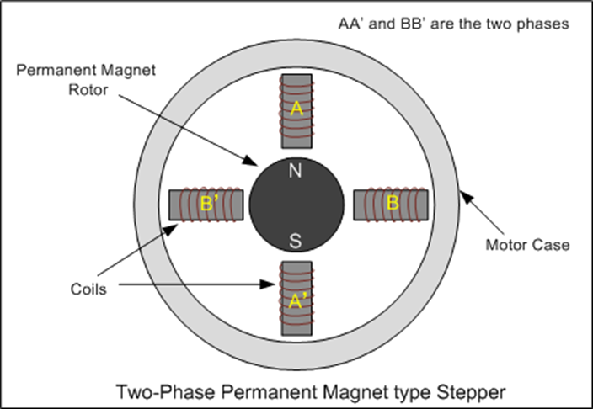
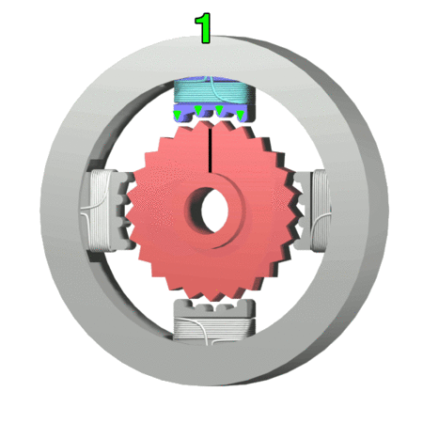
Stepper motors consist of a rotor (rotating part) and stator (stationary part), with the rotor containing multiple toothed poles and the stator housing electromagnets. By energizing the electromagnets in a specific sequence, the magnetic field attracts the rotor's teeth, causing it to move in incremental steps. The rotation direction and angle can be controlled by varying the sequence and timing of the electrical pulses sent to the motor.

Slide 14
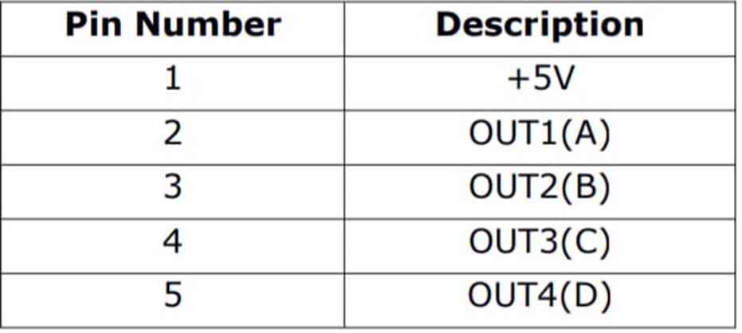
SPECIFICATION OF STEPPER IN LPC2148:
The Stepper motor can be interfaced to the board by connecting it into the Power Mate J11. It is interfaced through the high current driver ULN2803. These lines will have high current (max 300 mA) with low voltage level of 0.7V. The rotating direction of the stepper motor can be changed through software. Port lines used for Stepper motor are P0.12 – P0.15.
Stepper motor lpc2148 connection
Stepper motor connector j11 jumper connection which is internal

Slide 15
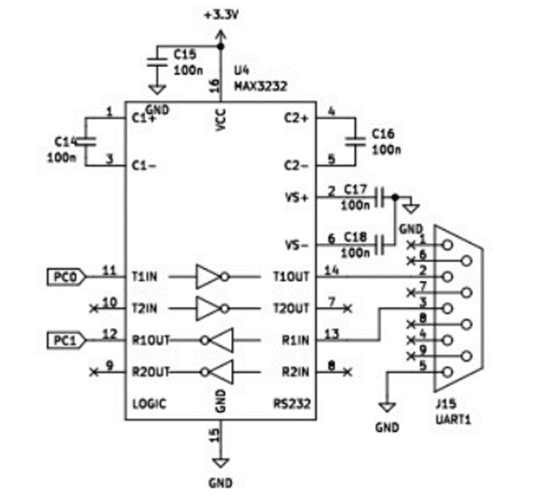
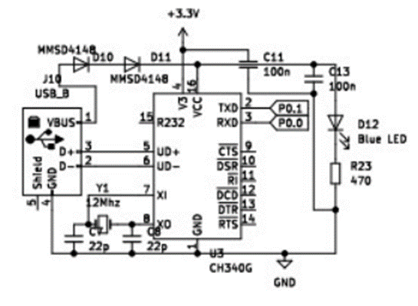
UART 0
UART 1

Slide 16
Calculations
Timer-
Count = (PCLK*basic time delay) - 1
Basetimevalue = 1ms
count(PR) = (pclk * basetimevalue) - 1
=(12MHz * 0.001 sec) - 1
= 11999
Stepper Motor-
Stepper motor takes 200 steps to complete one rotation i.e. 360 degrees.
(360/200)=1.8
Therefore it rotates 1.8 degrees per step.
For every 3 revolutions of DC motor, one carton is moved on Conveyor belt
For every 90 degree of stepper motor, the empty carton is discarded

Slide 17
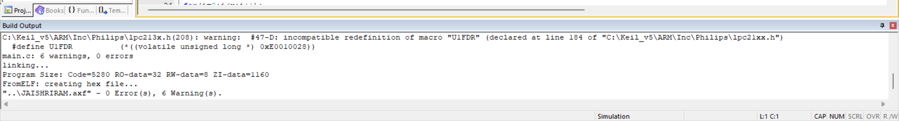
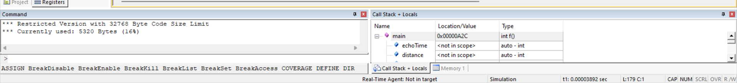
MEMORY ANALYSIS

Slide 18
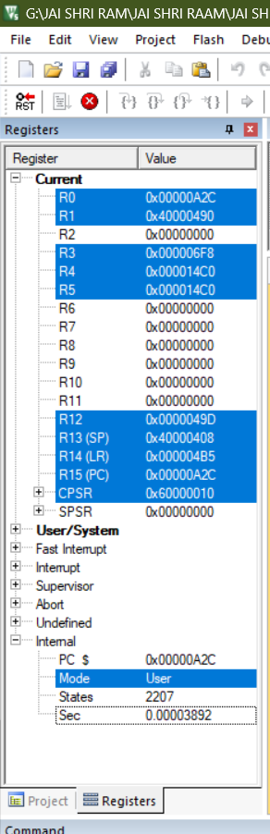
TIME ANALYSIS
TIME USED :- 0.562962 sec

Slide 19
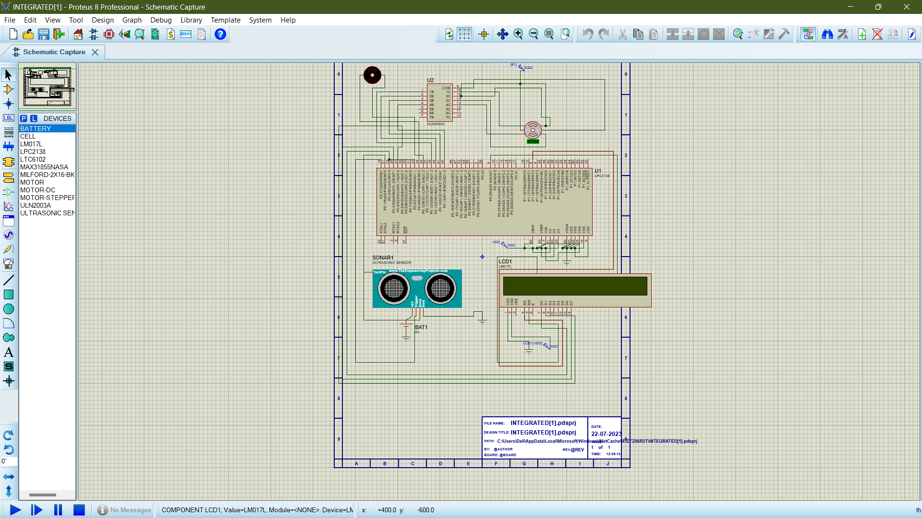

Slide 20
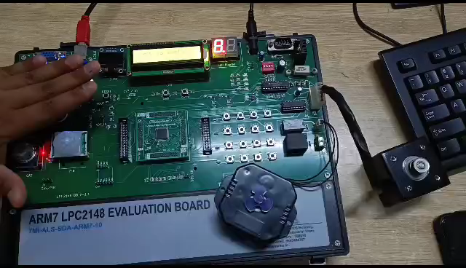
IMPLEMENTATION

Slide 21


THANK YOU

